Slide 1
Junior year college planning
Ms. Hogan, college adviser

Slide 2
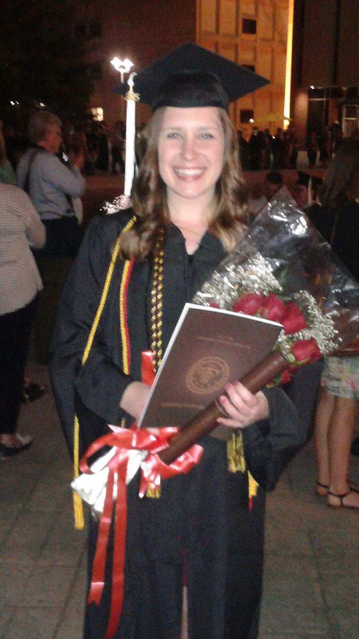
Introduction
Ms. Hogan
College Adviser
First-Generation College Graduate
2015 WMU Graduate
Majors: English & Spanish
Minor: Speech & Hearing Processes

Slide 3
What we will cover today:
College match and fit
Financial aid
Preparation, planning, and timeline

Slide 4
College match and fit

Slide 5
College Match and fit
Match
fit
Test scores
GPA
Graduation and retention rates
Location
Size
Cost
Majors offered
Sports
Clubs
Diversity

Slide 6
Begin your search with match
REACH
MATCH
SAFETY
Notes:
At this point, it is good to have a long list of colleges. Try to come up with a list of about 5 colleges that fall in each of these categories strictly based on GPA and test scores.

Slide 7
Determining reach, match, and safety:
Graduation Rates > Selectivity
4-yr & 6-yr
Freshman retention
Target Graduation Rates
Reach: 70%
Match: 63%
Safety: 52%
ACT and GPA Graph
College Results
MI College Guide
Notes:
Graduation rates are more important than selectivity. But, in general, more selective institutions have higher graduation rates.
Why is match important? Match/Reach schools = more likely to graduate

Slide 8
Determining fit
College Raptor
Big Future
Campus visits
School websites
Friends and family
Location
Size
Majors
Diversity
Religious
Cost
Financial Aid
Notes:
After you have a list of reach, match, and safety schools, evaluate each school based on fit

Slide 9
What if…
My school is a good FIT but not a good MATCH?
Honors colleges/programs
Research
On campus jobs
Leadership roles in campus organizations
Internships

Slide 10
Financial aid

Slide 11
How much does college cost?
Sticker price vs. net cost
College Board Net Price Calculator
College Abacus
Net Price Calculator on college’s website

Slide 12
Types of financial aid
Grants
Scholarships
Loans
Other: work-study, savings

Slide 13
grants
What are they
How to get them
Free money
Never have to pay back
Based on financial need or demographics
Apply to college before financial aid deadlines
Submit your FAFSA before March 1st of your senior year
Research Michigan’s Student Scholarships and Grants: http://www.michigan.gov/
Notes:
Very important to identify as having free or reduced lunch
Very important to know what Michigan SSG programs you might qualify for- low income, medicaid, native american, foster care, etc.

Slide 14
Very Important!!!
Be able to identify with the things that may qualify you for more aid:
Free and reduced Lunch
First Generation College
Foster Care
Native American
Medicaid coverage
Military/Veteran Status
Child of Police Office/Fire Fighter killed in line of duty

Slide 15
Scholarships
What are they
How to get them
Free money
Do not have to pay back
Usually based on merit, talent, activity, demographics, financial need
Apply to colleges before financial aid deadlines
Research
Apply
Stay organized

Slide 16
loans
What they are
How to get them
Money you have to pay back with interest
Submit your FAFSA before federal deadline: June 30
Apply with private companies, banks, credit unions

Slide 17
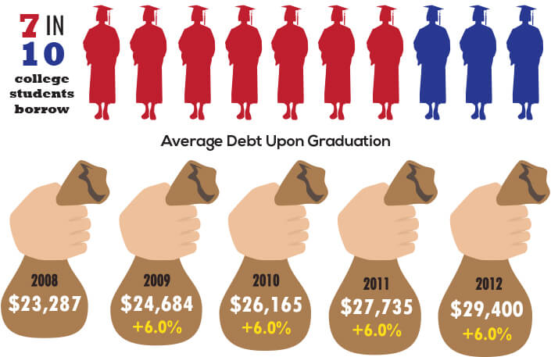
Reality of student loans
Notes:
Picture: http://www.collegechoice.net/is-college-still-worth-the-debt/

Slide 18
Reality of student loans
Avg. costs
Return on investment
Wedding: $20, 901
Car: $31, 252
Home: $135,000
Despite rising student debt rates, college is still worth it
Pay Scale ROI
Notes:
Wedding: Avg. cost in 2012 in Lansing and GR areas Source: http://www.mlive.com/business/index.ssf/2012/08/weddings_cost_michigan.html
Car: US average 2015 Source: http://money.usnews.com/money/personal-finance/articles/2015/01/02/a-glimpse-at-your-expenses-100-years-ago
Home: Avg. sale price in Michigan Source :http://www.realtor.com/local/Michigan/home-prices?v7=1
Making the right choices, makes it WORTH it

Slide 19
Preparation & Planning

Slide 20
What should you do now?
College notebook, folder, Google doc
List of colleges
Résumé, list of activities, honors, and awards
Letters of recommendation
Timeline of important dates and deadlines
Financial aid search
Professional and regular e-mail use
Memorize SSN
Notes:
Start gathering all your college information in ONE PLACE. This should include your list of colleges to consider, information about their admissions process, admissions contacts, helpful websites, account information, possible scholarships, due dates, etc
Approx. 15 schools. Analyze for match and fit
Create or update
Start to think about this
Will provide one but you should adjust for your personal use
Become familiar with your financial situation. Talk to your family. Research federal and state grant programs. Research local scholarships and scholarships of the schools you are interested in. Use net price calculators
Necessary for communication with colleges. Organize.
Makes the process easier and quicker

Slide 21
Important dates

Slide 22
April 12th
SAT at Saugatuck High School

Slide 23
June-August
Go on campus visits

Slide 24
August-September
Begin applications
Retake SAT

Slide 25
October 1st
FAFSA Opens
Notes:
Prior prior year taxes

Slide 26
End of October
College Application Week!
Notes:
Prior prior year taxes

Slide 27
November 1st
Early Action deadlines begin
Notes:
U of M and Hope: Nov 1
K College: Nov 15
CMU Scholarship consideration: Nov 15
This should be your goal for completing all your applications

Slide 28
March 1st
Michigan FAFSA Deadline

Slide 29
March
Complete scholarship applications
Notes:
Many scholarship deadlines are in mid-March. Although some could be much earlier, including late February (or even fall!!)
Most Local Scholarships have deadlines between late February-Mid March

Slide 30
May 1st
College Decision Day
Notes:
You have until May 1st to compare financial aid awards and weigh your options. Only send your enrollment deposit to ONE school.

Slide 31
June 30th
Federal FAFSA Deadline
Notes:
You have until May 1st to compare financial aid awards and weigh your options. Only send your enrollment deposit to ONE school.

Slide 32
Now-Senior Year timeline
April 12/13 :Take your SAT
Summer :Visit college campuses
August-September:
Begin your college applications!
Retake your SAT.
October 1st: FAFSA opens!
End of October: College Application Week
November 1st: Early action deadlines begin
March 1st : Michigan FAFSA deadline
March: Complete scholarship applications
May 1st: College Decision Day
June 30: Federal FAFSA deadline
Notes:
*November 1st* should be your goal deadline for applications! Why? Not just beginning of early action deadlines (1st is u of m and hope, 15th is K College) but even less selective schools may have early deadlines for scholarship consideration (CMU is Nov. 15th) Special note: early action vs early decision

Slide 33
Contact me:
Ms. Hogan
Tuesdays and Thursdays @ Saugatuck
Between MAC Lab, Room 4, and Media Center
ehogan@saugatuckps.com
Twitter: @SHSAdviser

